Slide 1
Natural Language Processing

Slide 2
Introduction to Natural Language Processing
Notes:
Trainer Notes:
1. Read title and subtitle
Estimated Duration (20 seconds)

Slide 3

Learning Objectives
By the end of this lesson, you will be able to:
Describe natural language processing and its components
Explain the different applications of NLP
Define and demonstrate text processing

Slide 4
Introduction to NLP

Slide 5
What Is NLP?
Natural Language Processing (NLP) is a branch of AI.
It helps machine to deal with human languages.
Human Language
AI
NLP
It helps machine to understand, interpret, and manipulate human languages.
Computer Science
Most of the Natural Language Processing techniques depend on machine learning to derive meaning from human languages.

Slide 6
Interaction between Humans and Machines Using NLP
1
Human talks to the machine
6
2
Machine responds to the human through the audio file
Machine captures the audio
5
3
Data to audio conversion
Audio to text conversion
4
Processing of the text data

Slide 7
History of NLP
1950
1990
2010
The work of the Linguistic Scientist Chomsky and others, on formal language theory and generative syntax, began.
A large quantity of spoken and textual data became accessible.
NLP started when Alan Turing revealed an article known as "Machine and Intelligence tries to automatize translation between Russian and English".
Probabilistic and data-driven models had become quite normal.
Representation of learning and deep neural network in natural language processing started.
1960
2000

Slide 8
Human Language
To understand NLP, let us first understand the human language.
Alphabets
Word: Combination of Alphabets
Apply Grammar Rules
Sentence: Combination of Words
Meaningful Sentence

Slide 9
Why NLP
Text is the largest repository of human knowledge and is growing quickly
02
03
NLP represents computer programs that understand text or speech
01
NLP is the hallmark of human intelligence

Slide 10





Need for NLP
Collections
Organization
Words
Packaged
Data Sources
Unstructured
Text
Big Data
Facilitate
Data
Patterns
Originates
none
How to analyze this unstructured data?
Use Text Mining

Slide 11
Understanding Text Mining
It is also called text analysis.
Process of deriving insights from natural language text
This is where NLP helps
Structure the input text
Derive pattern
Evaluate output

Slide 12
How NLP Works
Sequence
Preprocessing
Text to Features
02
01
04
03
Usage of NLP Libraries
Usage of NLP Models

Slide 13




Different Aspects of NLP
01
NLP is the ability of a computer to analyze, understand, and generate human languages.
02
A language is a system, a set of rules or set of symbols.
03
Symbols are combined and used for conveying information or broadcasting the information.
04
In NLP, rules of grammar are used for handling symbols.
05
NLP is a component of artificial intelligence.

Slide 14
Categories of NLP
Rule-Based NLP
Statistical NLP
Designed by creating a set of rules
Developed by heuristic rules
Relies heavily on machine learning
Applies automatic learning procedure
Statistical Revolution

Slide 15
Techniques Used in NLP
NLP
Syntactic Analysis
Semantic Analysis
Focuses on arrangement of words
Aligns with grammatical rules
Meaning of a text
Sentence structure understanding
Interpretation of words

Slide 16
Components of Natural Language Processing

Slide 17

Components of Natural Language Processing
Natural Language Processing
1
Natural Language Understanding (NLU)
NLU
NLG
Natural Language Generation (NLG)
2

Slide 18
Components: Natural Language Understanding (NLU)
Taking some sentences and finding out what they mean

Slide 19
Components: Natural Language Generation (NLG)
Taking some formal representation of what you want to say and working out a way to express it in a natural language
1
Mapping the given input in the natural language with a useful representation
2
Producing output in the natural language from some internal representation
3
Different level of analysis: morphological analysis, syntactic analysis, semantic analysis, and discourse analysis
4

Slide 20
Uses of NLP
Use of NLP in conversational bot in each step:
Users Request
Intent Identification
Entity Extraction
Content Management, History Processing, Session Management
Response Generation
Natural Language Understanding
Natural Language Generation

Slide 21
Applications of Natural Language Processing

Slide 22




NLP in Real-Life
Speech Recognition
Machine Translation
Information Retrieval
Chatbot

Slide 23




NLP in Real Life
Information Extraction
Question Answering
Sentiment
Analysis
Spell Check

Slide 24
NLP in Real-Life: Business Usage
Improve user experience
Spellcheck
Autocomplete
Autocorrect
Automate support
Chatbot
Product ordering
Monitor and analyze feedback
Generate actionable insight from huge amount of review or feedback

Slide 25

NLP in Real-Life: Speech Recognition
"Alexa, turn on Welcome Home"
"Alexa, turn off my Bedroom Sonos"
Google Assistant
Siri
Alexa
Cortana
"Alexa, turn on my Chill Time"
"Alexa, turn on the TV"

Slide 26
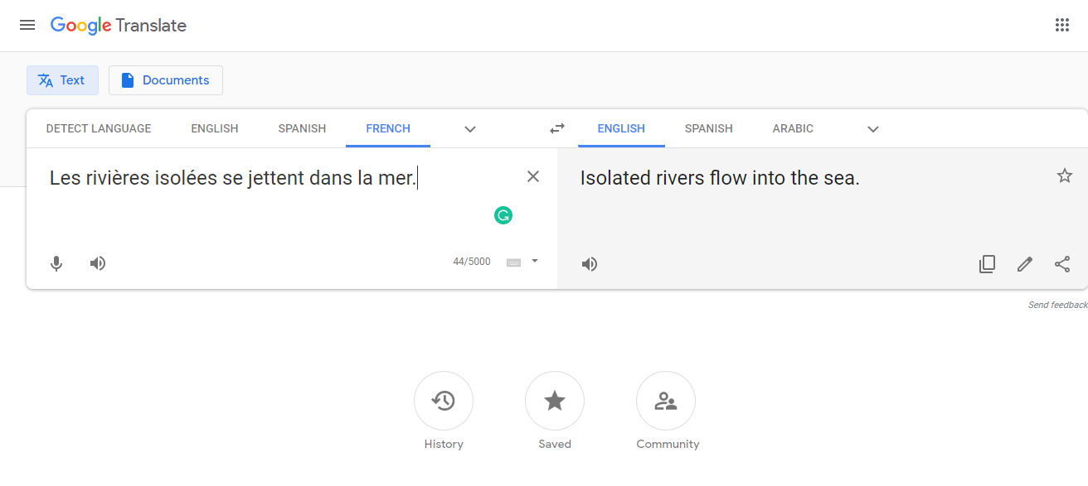

NLP in Real-Life: Machine Translation
Google translator

Slide 27
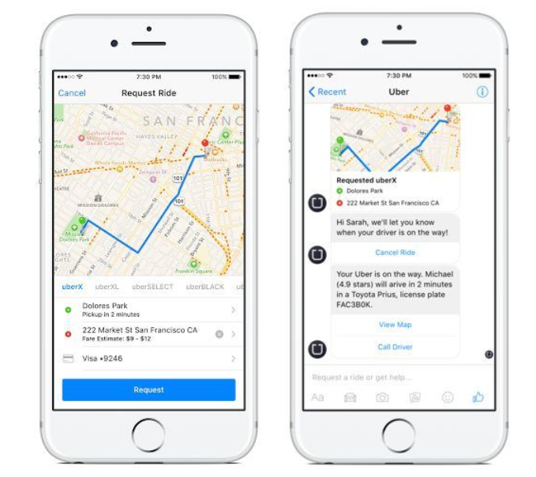
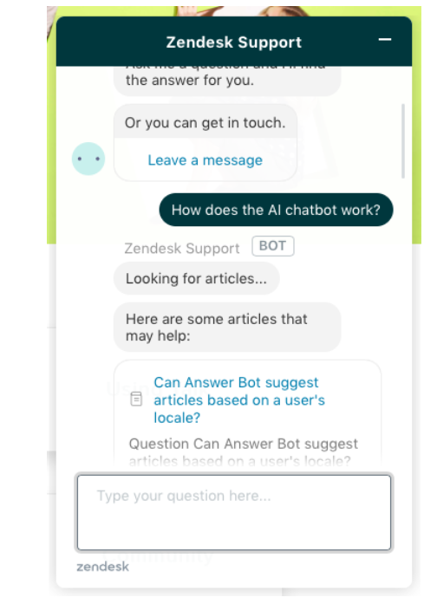
NLP in Real-Life: Chatbots
Uber, Facebook Messenger, and Zendesk are some of the companies who have implemented chatbots using NLP.
Source

Slide 28
NLP in Real-Life: Information Retrieval
Find information according to the given query
Collections
Audio
NLP techniques used in IR are:
Stemming
Part-of-Speech Tagging
Compound Recognition
Decompounding
Chunking
Word-Sense Disambiguation
Words
Video
Organization
Packaged
Data
Involve
Sentences
Text
Big Data
Facilitate
Unstructured
Patterns
none
Originates
Google finds relevant and similar results using Information Retrieval.

Slide 29
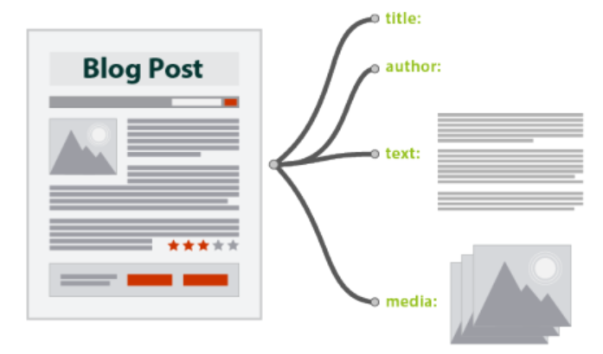
NLP in Real-Life: Information Extraction
Automatic extraction of structured information from unstructured or semi-structured machine-readable documents
Gmail structures events from e-mails
Source

Slide 30
NLP in Real-Life: Information Extraction
Raw Text (String)
Sentence Segmentation
Sentences (List of strings)
Tokenization
Tokenized Sentences (List of list of strings)
Parts-of-Speech Tagging
PoS Tagged Sentences (List of list of tuples)
Entity Recognition
Chunked Sentences (List of trees)
Relation Recognition
Relations (List of Tuples)

Slide 31
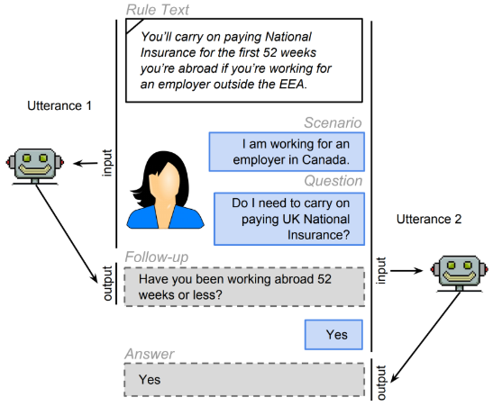

NLP in Real-Life: Question Answering
System that automatically answers questions
Source

Slide 32
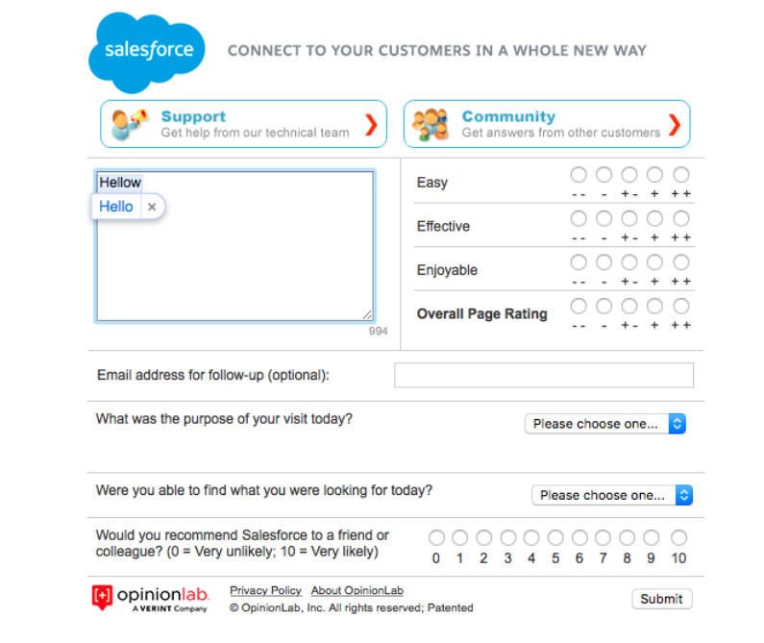

NLP in Real-Life: Spell Check
Salesforce implemented spell check in the contact forms using NLP.
Grammarly: A grammar checking SW built on NLP
Source

Slide 33
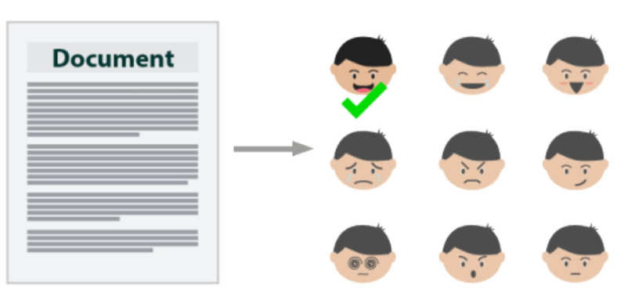
NLP in Real-Life: Sentiment Analysis
To extract subjective information from a piece of text
Example: Whether an author is being subjective or objective or even positive or negative
NLP is used here
Source

Slide 34
Challenges and Scope

Slide 35
Why NLP Is Difficult
Nature of the human language
Rules that dictate the passing of information using natural languages are not easy for computers to understand.
Human language is unstructured data
Only 21% of the data is structured data, and a lot of information in the world is unstructured.
Tough to extract meaning from text
Process of reading and understanding English is very complex.

Slide 36
Challenges and Scope
Semantic Meaning
Understanding a word with respect to its context
Word-Sense Disambiguation
Actual context of the text
Challenges
Entity Extraction
Extracting the unknown entities
Multiple Intents
User speaking many things in single text
Anaphora Resolution
Absence of important entity in text conversation

Slide 37
Challenges and Scope: Semantic Meaning
There are many good properties available on HDFC Red portal.
I want to purchase a red carpet from a store.
Word RED has different meanings in these contexts.

Slide 38
Challenges and Scope: Understanding Entities
A 2M solution of CaCl2 consists of 221.82g of CaCl2 dissolved in enough water to make one liter of solution.
Understanding and extraction of CaCl2 as entity in this context is complex.

Slide 39
Challenges and Scope: Anaphora Resolution
Peter and Greg are NLP developers. He is living in Pune.
The word “He” used in 2nd sentence does not specify which person to refer.

Slide 40
Challenges and Scope: Multiple Intents
My bank account is functional. Please provide me resolution process and I want to buy Laptop from Flipkart.
The word “He” used in 2nd sentence does not specify which person to refer.

Slide 41
NLU Challenges: Ambiguity
Lexical Ambiguity
More than 1 meaning of a word in a sentence
Example: The fisherman went to the bank.
Syntactic or Grammatical Ambiguity
More than 1 meaning of a sentence
Example : Visiting relatives can be boring.
Referential Ambiguity
Reference of a pronoun
The boy told the father about the theft. He was very upset.

Slide 42
Data Formats

Slide 43
Data Formats
To apply NLP on data, we need to have the data which is available on different kinds of sources in different formats.
Below are the types of data formats:
Structured
Unstructured
Semi-Structured

Slide 44
Data Formats: Structured
Excel, CSV
 | SQL Data

Slide 45
Data Formats: Unstructured and Semi-Structured
JSON
Text
Image

Slide 46
NLP Pipeline

Slide 47
NLP Pipeline
Raw Text
Text Processing
Feature Extraction
Modeling
May need to come back to text processing if feature extraction is not proper
May need to come back to feature extraction if modeling is not as desired

Slide 48
Text Processing

Slide 49




Text Processing
Text Processing
Input Information Source
Output

Slide 50
Sequence or Text Processing
Sequence or Text Processing has the following steps:-
5
4
3
Modified Text
2
Standardization of Text
Regular Expressions
1
Word Normalization
Noise
Entity Removal
Tokenization
Stemming
Lemmatization
Raw Text
Stop words
URLs
Punctuations
Numbers

Slide 51
Sequence or Text Processing: Noise Entity Removal
Convert all the words of document into lowers case
Noise Entity Removal
For efficient processing, we must keep all words in same casing to avoid case sensitivity of text.
Eliminating unnecessary punctuations, stop words, numbers, and URLs
These types of things do not contribute for better result. They only increase the size of texts and decrease the efficiency of algorithms.

Slide 52
Sequence or Text Processing: Tokenization
Tokenization
Break the sentence into separate words.
These words are called tokens.
Split words whenever there is a space between them.
Treat punctuation marks as separate tokens since punctuation also has meaning.
Example:
Sentence | Word
London is the capital and the most populous city of England and the United Kingdom | “London”, “is”, “ the”, “capital”, “and”, “ the”, “most”, “populous”, “city”, “of”, “England”, “and”, “the”, “United”, “Kingdom”

Slide 53
Sequence or Text Processing: Stemming
Stemming:
Plays
It takes the root of the words.
It removes the last few words or suffix of a word where it misspelt or incorrect words.
PLAYER
PLAY
Playing
Example:
Word | Suffix | Stem
studies | -es | studi
ninez | -ez | nin
Played

Slide 54
Sequence or Text Processing: Lemmatization
Lemmatization:
It converts the text to meaningful base form by considering its context.
Example:
Word | Morphological Information | Lemma
Studying | Gerund of the word study | Study
Ninez | Singular number of nine | Ninez

Slide 55
Sequence or Text Processing: Chunking and Chinking
It is simplest technique used for entity detection
05
It is the process of extracting meaningful short phrases from sentences by analyzing the parts of speech
01
04
Words or patterns can also be defined. These should not be a part of chunk and such words are known as chinks
Chinking a way to remove a chunk from chunk
02
03
Chunk pattern are made by normal regular expression which are designed and modified to match the part of speech tags

Slide 56
Sequence or Text Processing: Regular Expression
Object Standardization:
Some words or symbols which are not present in standard dictionary are also not recognized by any search processes.
Examples: hashtags, acronyms, and colloquial slangs
Note: With the help of regular expression, we can remove these things.

Slide 57
Sequence or Text Processing: Regular Expression
Regular Expression (Regex):
It is a sequence of characters that define pattern-matching, search-and-replace, and elimination functions. All type of noises can be removed with the help of regular expressions.
Regex Examples:
Expression | Description
[abc] | Find any character between the brackets
[^abc] | Find any character that is not between the brackets
[0-9] | Find any character between the brackets (digit)

Slide 58
NLTK

Slide 59
NLTK: Introduction
This tool is used for manipulation or understanding text or speech by any software or machine.
1
This is one of the most usable and mother of all NLP libraries.
2
It is a platform used for building Python programs that work with human language data for application in statistical Natural Language Processing (NLP).
3

Slide 60
NLTK: Introduction
Following are text processing libraries:
Tokenization
Lemmatization
Parsing
Classification
Stemming
Tagging
Semantic Reasoning

Slide 61
NLTK: Syntax and library
System Requirement:
Operating System:
macOS / OS X · Linux · Windows (Cygwin, MinGW, Visual Studio)
Python Version:
Python 2.7, 3.5+ (only 64 bit)
>> import nltk

Slide 62
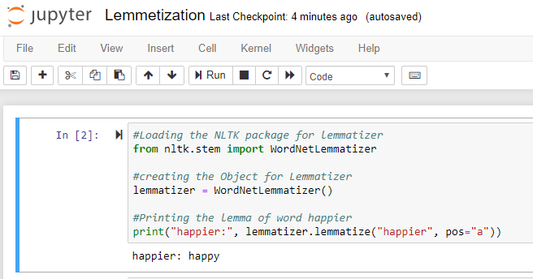
NLTK: Lemmatization
For grammatical purpose, documents are going to use different forms of a word, for example:
#Loading the NLTK package for lemmatizer
from nltk.stem import WordNetLemmatizer
#creating the Object for Lemmatizer
lemmatizer = WordNetLemmatizer()
#Printing the lemma of word happier
print("happier:", lemmatizer.lemmatize("happier", pos="a"))
Output: happier: happy
Notes:
Trainer Notes:
#Loading the NLTK package for lemmatizer
from nltk.stem import WordNetLemmatizer
#creating the Object for Lemmatizer
lemmatizer = WordNetLemmatizer()
#Printing the lemma of word happier
print("happier:", lemmatizer.lemmatize("happier", pos="a"))
1. Read the slide title
2. Read the line written in the blue box
3. Explain the following
a. Why importing file is always the first step to start
b. The significance of path to file
Estimated Duration (45 seconds)

Slide 63
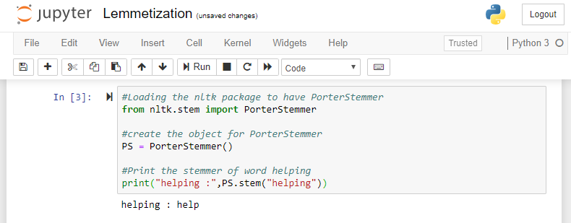
NLTK: Stemming
#Loading the nltk package to have PorterStemmer
from nltk.stem import PorterStemmer
#create the object for PorterStemmer
PS = PorterStemmer()
#Print the stemmer of word helping
print("helping :",PS.stem("helping"))
Output: helping: help

Slide 64
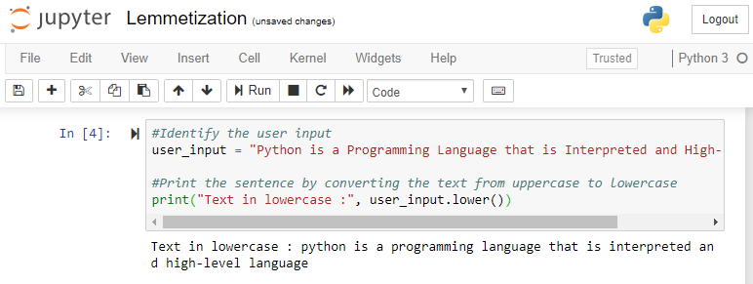
NLTK: Processing Raw Text
Text processing includes:
Converting all letters to lower or upper case
#Identify the user input
user_input = "Python is a Programming Language that is Interpreted and High-Level language"
#Print the sentence by converting the text from uppercase to lowercase
print("Text in lowercase :", user_input.lower())
Output: Text in lowercase : python is a programming language that is interpreted and high-level language.

Slide 65
NLTK: Processing Raw Text
Converting numbers into words or removing numbers
#Loading the regex package to find number
import re
#identify user input
input_str = "Team A has 6 batsman and 5 bowlers, while team b has 5 batsman and 6 bowlers"
#remove numbers by using regex
output = re.sub(r"\d+", "", input_str)
#print the sentence after removal of numbers
print("remove numbers :", output)

Slide 66
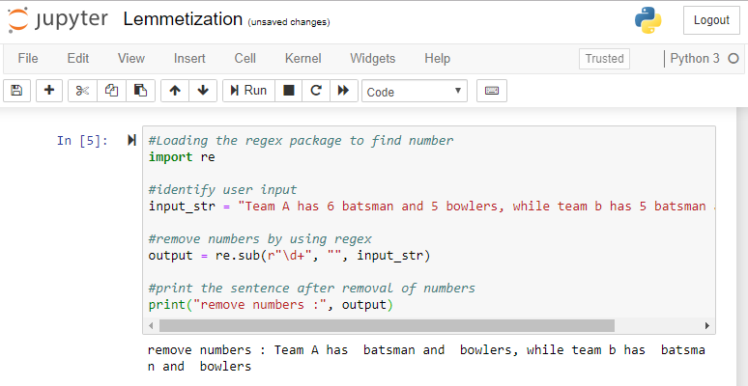
NLTK: Processing Raw Text
Output: remove numbers : Team A has batsman and bowlers, while team b has batsman and bowlers

Slide 67
NLTK: Processing Raw Text
Removing accent, punctuations marks, and other diacritics
#Load the regex package and string package
import re, string
#define user input
input_str = "Sentence. having. string with. Punctuation?"
#remove punctuation
result = re.sub('[%s]' % re.escape(string.punctuation), '', input_str)
#print the sentence after removal of punctuation
print("result after removing punctuation :", result)

Slide 68
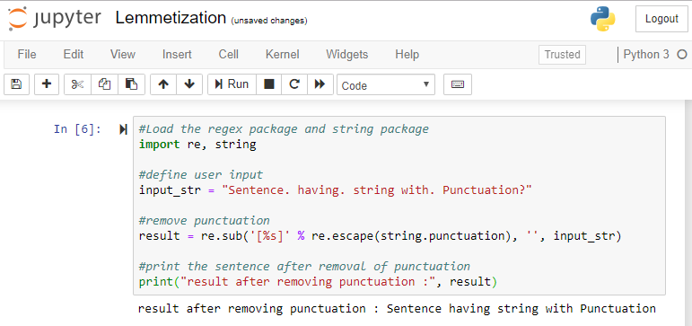
NLTK: Processing Raw Text
Output: result after removing punctuation : Sentence having string with Punctuation

Slide 69
NLTK: Processing Raw Text
Removing white spaces:
#Load the regex and string package
import re
#define input from user
input_str = 'pythonis programming language \t\n\r\tHello \t'
#Print the sentence after removing the spaces
print('Remove spaces using regex :', re.sub(r"\s+", "", input_str),"\n", sep='')
#Print the sentence after removing the landing spaces
print('Remove landing spaces using regex :', re.sub(r"^\s+", "", input_str),"\n", sep='')
#Print the sentence after removing the trailing spaces
print('Remove trailing spaces using regex :', re.sub(r"\s+$", "", input_str),"\n", sep='')
#Print the sentence after removing the leading and trailing spaces
print('Remove landing spaces using regex :', re.sub(r"^\s+|\s+$", "", input_str),"\n", sep=‘’)

Slide 70
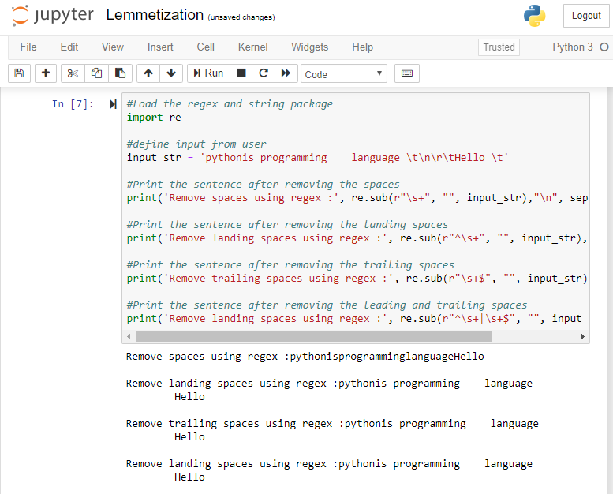
NLTK: Processing Raw Text
Output:
Remove spaces using regex :pythonisprogramminglanguageHello
Remove landing spaces using regex :pythonis programming language
Hello
Remove trailing spaces using regex :pythonis programming language
Hello
Remove landing spaces using regex :pythonis programming language
Hello

Slide 71
NLTK: Stopwords
#Load the stopwords package
from nltk.corpus import stopwords
#Load the word tokenizer package
from nltk.tokenize import word_tokenize
#define the user input
input_str = "Stop words are the words that are filtered before and after processing of text."
#crete object for stopwords
stop_word = set(stopwords.words("english"))
#convert word into tokens
token = word_tokenize(input_str)
#remove stopwords from the list of tokens
output = [i for i in token if not i in stop_word]
#remove the stopwords and print the sentence
print("remove stopwords :", output)

Slide 72
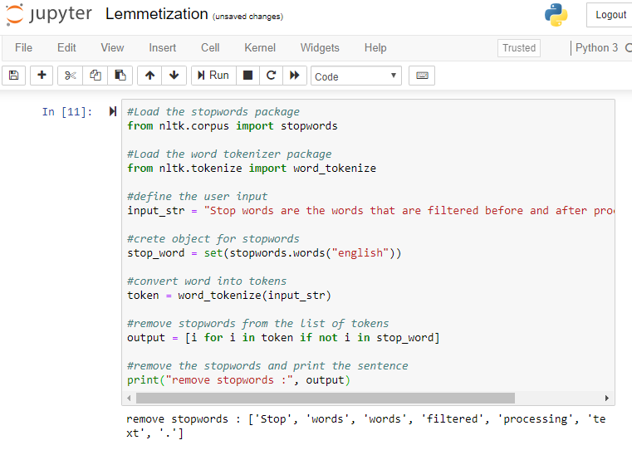
NLTK: Stopwords
Output: remove stopwords : ['Stop', 'words', 'words', 'filtered', 'processing', 'text', '.']

Slide 73
NLTK: Tokenizers
#Load the package for tokenizer
from nltk.tokenize import sent_tokenize
#defining user input
text = "Tokenization is the way of tokenizing or dividing a string, text into a list of tokens"
#print the tokens of sentence.
print("after removing stopwords :", sent_tokenize(text))

Slide 74
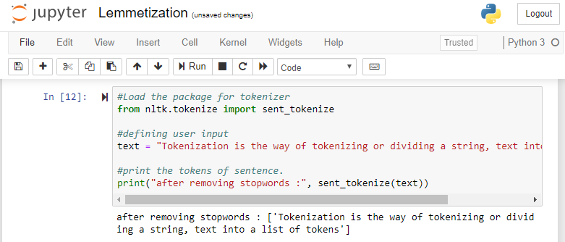
NLTK: Tokenizers
Output: after removing stopwords : ['Tokenization is the way of tokenizing or dividing a string, text into a list of tokens']

Slide 75
NLTK: Ngram
#Load the package for ngrams
from nltk import ngrams
#define user input
usr_input = 'i want to ngramize the foo bar sentences'
#define number of gram
n = 3
#split the sentence to make grams
sixgrams = ngrams(usr_input.split(), n)
for grams in sixgrams:
#Print the 3 grams of user-input
print(grams)

Slide 76
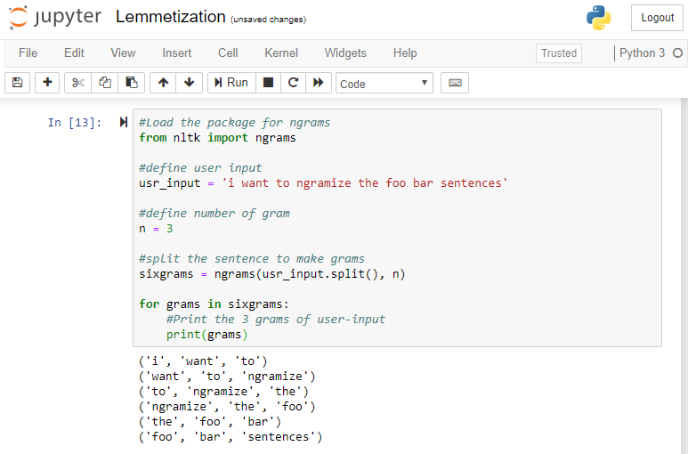
NLTK: Ngram
Output:
('i', 'want', 'to')
('want', 'to', 'ngramize')
('to', 'ngramize', 'the')
('ngramize', 'the', 'foo')
('the', 'foo', 'bar')
('foo', 'bar', 'sentences')

Slide 77
NLTK: Limitations
Does not support word vectors
1
Is slow
2
Not for production purpose
3
Good only for English and difficult for other languages
4

Slide 78
Re

Slide 79
Re: Introduction
Re is an inbuilt library which comes with python.
It uses a set of symbols to identify the patterns from the text.
Example: email address ^([a-zA-Z0-9_\-\.]+)@([a-zA-Z0-9_\-\.]+)\.([a-zA-Z]{2,5})$
It is used in information retrieval: import nltk
import re

Slide 80
Text Processing Using Stemming and Regular Expression
Problem Statement: Demonstrate text processing using stemming and regular expression.
Access: Click on the Practice Labs tab on the left side panel of the LMS. Copy or note the username and password that is generated. Click on the Launch Lab button. On the page that appears, enter the username and password in the respective fields, and click Login.

Slide 81
Tweets Cleanup and Analysis Using Regular Expressions
Objective: Use regular expressions to work with messy tweets data: clean up the data, extract hashtags, analyze the most popular hashtags that occur along with a target hashtag (#economy).
Problem Statement: Social media is a gold mine of information. Brands, governments, or anyone can leverage their business with the help of the information contained. It can be information on the sentiments for a brand, or the themes being spoken about , or the associated trends for a particular hashtag. In this project, we will work on the tweets on Twitter. We will find other hashtags that occur frequently with our target hashtag. This will give us an understanding of which other topics people are associating this hashtag with.

Slide 83
One of the main challenges of NLP is _____________.
1
Handling ambiguity of sentences
Handling tokenization
Both a and b
None of the above

Slide 84
One of the main challenge of NLP is _____________.
1
Handling ambiguity of sentences
Handling tokenization
Both a and b
None of the above
a.
One of the main challenges of NLP is handling ambiguity of sentences.

Slide 85
Regular expression is used for_______.
2
Information retrieval
Finding the pattern
Database management
Both a and b

Slide 86
Regular expression is used for_______.
2
Information retrieval
Finding the pattern
Database management
Both a and b
d.
Regular expression is used for information retrieval and finding the pattern.

Slide 87
NLP is the technique of interpretation of all types of languages which includes ___________.
3
Human Language
Assembly Language
Machine Language
Binary Data

Slide 88
NLP is technique for interpretation of all type of languages which includes ___________.
3
Human Language
Assembly Language
Machine Language
Binary Data
a.
NLP has its focus on understanding the human spoken or written language and converting that interpretation into machine understandable language.

Slide 89
Natural Language Processing (NLP) is a field of _______________.
4
Computer Science
Artificial Intelligence
Linguistics
All of the above

Slide 90
Natural Language Processing (NLP) is a field of _______________.
4
Computer Science
Artificial Intelligence
Linguistics
All of the above
d.
Natural Language Processing is a field of computer science, artificial intelligence, and linguistics.

Slide 91
Which of the following techniques can be used for the purpose of keyword normalization?
1- Lemmatization 2- Levenshtein 3- Stemming 4- POS
5
1 and 2
2 and 4
1 and 3
1,2, and 3

Slide 92
Which of the following techniques can be used for the purpose of keyword normalization?
1- Lemmatization 2- Levenshtein 3- Stemming 4- POS
5
1 and 2
2 and 4
1 and 3
1,2, and 3
c.
Lemmatization and stemming are the techniques of keyword normalization.

Slide 93
Key Takeaways
You are now able to:
Describe natural language processing and its components
Explain the different applications of NLP
Define and demonstrate text processing

